Slide 1
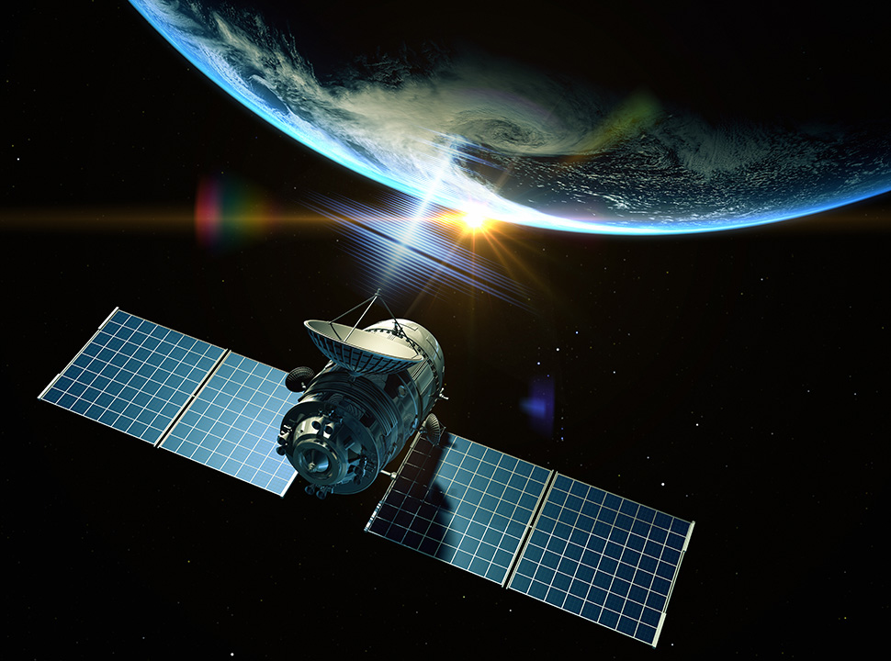
Space-based solar power
Megan Jorgensen
Mena Boley

Slide 2
Overview
History
Plan and implementation
Pros to the advancement
Cons to the advancement
Megan’s Summary
Mena’s Summary
Citations

Slide 3
History
1941 Isaac Asimov and Reason
First look at a space station using energy from the sun in fiction
1968
Introduction of Solar Power Satellite
1978
Examination of solar power satellite
1987
Stationary high altitude relay platform
1995
Nasa conducts study of space solar power
1998
Identification of credible, commercially viable solar power satellite
1999
SSP exploration research and technology program begins
Notes:
In 1941, science fiction writer Isaac Asimov published the science fiction short story "Reason", in which a space station transmits energy collected from the Sun to various planets using microwave beams. The SBSP concept, originally known as satellite solar-power system (SSPS), was first described in November 1968.^{[11]} In 1973 Peter Glaser was granted U.S. patent number 3,781,647 for his method of transmitting power over long distances (e.g. from an SPS to Earth's surface) using microwaves from a very large antenna (up to one square kilometer) on the satellite to a much larger one, now known as a rectenna, on the ground.^{[12]}
In addition, space-based solar naturally depends on solar cell technology. The first solar cell was patented in 1913, and the first modern silicon solar cell (which most ground-based solar cells today are still made of) was developed by Bells Labs in 1954. Since then, materials, efficiency, and design of devices to harness the sun’s almighty rays for energy steadily improved in the following century. Satellites, space-based telescopes, and even the International Space Station all in fact currently use solar power as their energy source; the challenge today is getting that energy back to earth for use here on the planet’s surface.

Slide 4
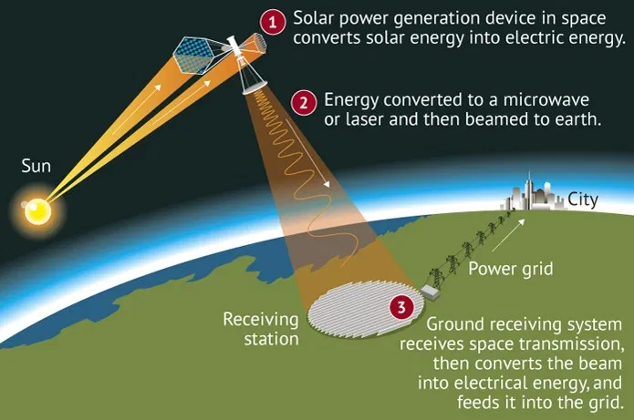
Plan and Implementation
Purpose
Help capture more sustainable energy
Turn solar energy into useable energy for a remote receiving station
Functionality
It can give solar power 24/7. It won’t be stopped by cloud cover, night, or the atmosphere.
How does it work?
Reflectors, a microwave/laser power transmitter, and self assembling satellites will be launched into space.
The reflectors would spread over a large area of space, directing solar energy onto solar panels.
These solar panels would convert solar power into a microwave/laser, and give uninterrupted energy to earth.
Notes:
Purpose- Space based solar power satellites (SPS) are large structures in space that convert solar energy, captured as solar irradiation, into a form of energy that is transmitted wirelessly (WPT) to any remote receiver station. This receiver could either be on Earth, or on a high altitude platform (aircraft), other spacecraft or even on the surface of the moon or other planets. The original idea took form in the 1970's by the Czech-US engineer Dr. Peter Glaser and ever since a variety of studies have been undertaken. These studies have led to a large diversity of concepts which use different forms of power generation, conversion and transmission principles.
Functionality- Solar panel equipped, energy transmitting satellites collect high intensity, uninterrupted solar radiation by using giant mirrors to reflect huge amounts of solar rays onto smaller solar collectors. This radiation is then wirelessly beamed to Earth in a safe and controlled way as either a microwave or laser beam.
-On earth, solar power is greatly reduced by night, cloud cover, atmosphere and seasonality. Some 30 percent of all incoming solar radiation never makes it to ground level. In space the sun is always shining, the tilt of the Earth doesn't prevent the collection of power and there’s no atmosphere to reduce the intensity of the sun’s rays. This makes putting solar panels into space a tempting possibility. Additionally, SBSP can be used to get reliable and clean energy to people in remote communities around the world, without relying on the traditional grid to a large local power plant.
How does it it work- Self-assembling satellites are launched into space, along with reflectors and a microwave or laser power transmitter. Reflectors or inflatable mirrors spread over a vast swath of space, directing solar radiation onto solar panels. These panels convert solar power into either a microwave or a laser, and beam uninterrupted power down to Earth. On Earth, power-receiving stations collect the beam and add it to the electric grid.

Slide 5
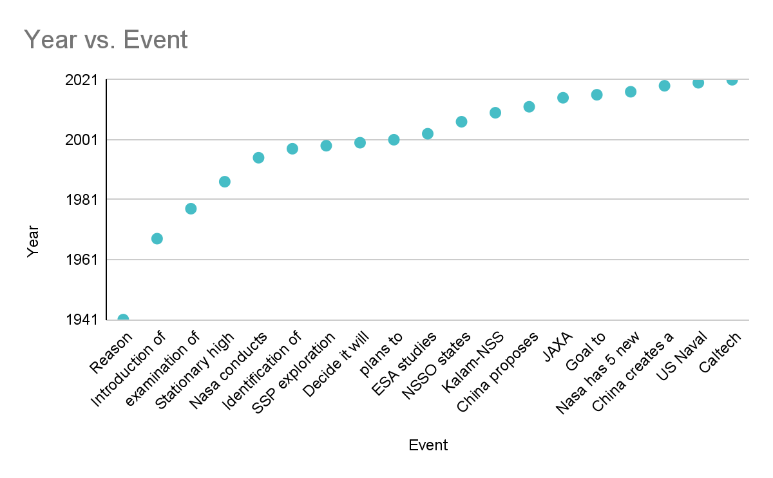
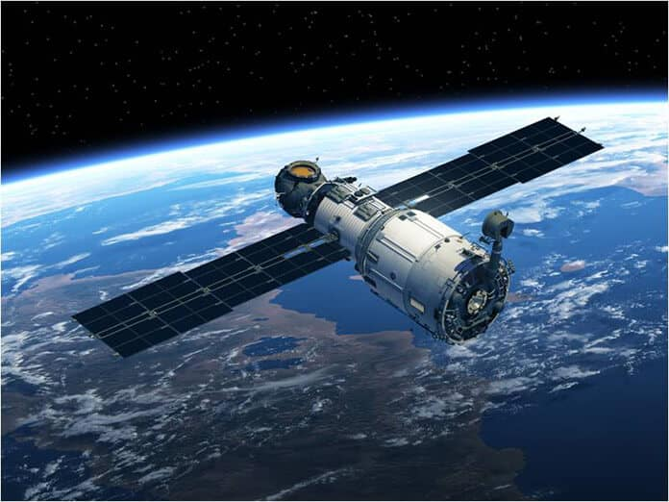
Timeline
Caltech launch by 2023
Notes:
The most recent development was made by Caltech and they plan to launch a test in 2023

Slide 6
Pros
This energy would be cleaner/better for the earth than fossil fuels.
The power wouldn’t be interrupted by the weather, nightfall, ect. like normal solar panels are.
Mostly all the disadvantages of solar energy are eliminated if the solar panels are in space.
Notes:
-On earth, solar power is greatly reduced by night, cloud cover, atmosphere and seasonality. Some 30 percent of all incoming solar radiation never makes it to ground level. In space the sun is always shining, the tilt of the Earth doesn't prevent the collection of power and there’s no atmosphere to reduce the intensity of the sun’s rays. This makes putting solar panels into space a tempting possibility. Additionally, SBSP can be used to get reliable and clean energy to people in remote communities around the world, without relying on the traditional grid to a large local power plant.
-The environmental disadvantages of solar energy include habitat loss, alteration in land use, the strain on water resources, exposure to hazardous materials, and pollution of soil, air, and water resources

Slide 7
Cons
A demo plant could cost $10 billion
The cost would inhibit the installation and the maintenance of the power satellites, restrict launch geography, and safety hazards.
Very experimental
There would have to be a lot of them because each receiving station can only power so much space.
Notes:
A demo plant could cost $10 billion
There have still been no large scale experiments to the device,so it is difficult to say if it will truly be functional and practical to spend the money
The glaring disadvantages to SBSP are launch costs, which inhibit both installation and maintenance of the power satellites, restrictive launch geography, and safety hazards.

Slide 8
Megan’s Summary
I think that it is a really good idea because it would be a more effective way to power cities. Electricity could be more widespread and efficient because we would no longer have to deplete all our natural resources that we now use for electricity. Compared to normal solar panels it would be more efficient because it would constantly be receiving energy from the sun, but during the night solar panels don’t get the energy.

Slide 9
Mena’s Summary
I support doing space-based solar power because it could eliminate some of the pollution that is attributing to greenhouse gases. It would be a lot more reliable than normal solar panels because it couldn’t be inhibited by nightfall, clouds, etc. It would be way more effective, and if we could make it widespread we could be using cleaner, safer energy

Slide 10
Citations
Space-based Solar Power by European Space Agency 14 April 2013
Space-Based Solar Power Department of Energy, March 6, 2014
We Have Lift-Off: A History of Space-Based Solar Power | Environmental Leadership, Action and Ethics
Space-Based Solar Power: A New Path Towards Sustainable, Clean Energy? – USC Viterbi School of Engineering.
Space-based solar power may answer Earth's energy needs. - ASME
5 Disadvantages of Solar Energy to the Environment

